Slide 1
Chapter 1: Introduction

Slide 2
Chapter 1: Introduction
What Operating Systems Do
Computer-System Organization
Computer-System Architecture
Operating-System Operations
Resource Management
Security and Protection
Virtualization
Distributed Systems
Kernel Data Structures
Computing Environments
Free/Libre and Open-Source Operating Systems

Slide 3
Storage Structure

Slide 4
Storage Structure
Main memory – only large storage media that the CPU can access directly
Random access
Typically volatile
Typically random-access memory in the form of Dynamic Random-access Memory (DRAM)
Secondary storage – extension of main memory that provides large nonvolatile storage capacity

Slide 5
Storage Structure (Cont.)
Hard Disk Drives (HDD) – rigid metal or glass platters covered with magnetic recording material
Disk surface is logically divided into tracks, which are subdivided into sectors
The disk controller determines the logical interaction between the device and the computer
Non-volatile memory (NVM) devices– faster than hard disks, nonvolatile
Various technologies
Becoming more popular as capacity and performance increases, price drops

Slide 6
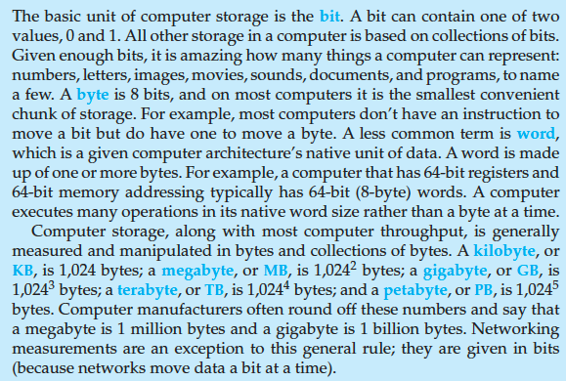
Storage Definitions and Notation Review
The basic unit of computer storage is the bit. A bit can contain one of two
values, 0 and 1. All other storage in a computer is based on collections of bits.
Given enough bits, it is amazing how many things a computer can represent:
numbers, letters, images, movies, sounds, documents, and programs, to name
a few. A byte is 8 bits, and on most computers it is the smallest convenient
chunk of storage. For example, most computers don’t have an instruction to
move a bit but do have one to move a byte. A less common term is word,
which is a given computer architecture’s native unit of data. A word is made
up of one or more bytes. For example, a computer that has 64-bit registers and
64-bit memory addressing typically has 64-bit (8-byte) words. A computer
executes many operations in its native word size rather than a byte at a time.
Computer storage, along with most computer throughput, is generally
measured and manipulated in bytes and collections of bytes. A kilobyte, or
KB , is 1,024 bytes; a megabyte, or MB, is 1,024² bytes; a gigabyte, or GB, is
1,024³ bytes; a terabyte, or TB, is 1,024⁴ bytes; and a petabyte, or PB, is 1,024⁵
bytes. Computer manufacturers often round off these numbers and say that
a megabyte is 1 million bytes and a gigabyte is 1 billion bytes. Networking
measurements are an exception to this general rule; they are given in bits
(because networks move data a bit at a time).

Slide 7
Storage Hierarchy
Storage systems organized in hierarchy
Speed
Cost
Volatility
Caching – copying information into faster storage system; main memory can be viewed as a cache for secondary storage
Device Driver for each device controller to manage I/O
Provides uniform interface between controller and kernel

Slide 8
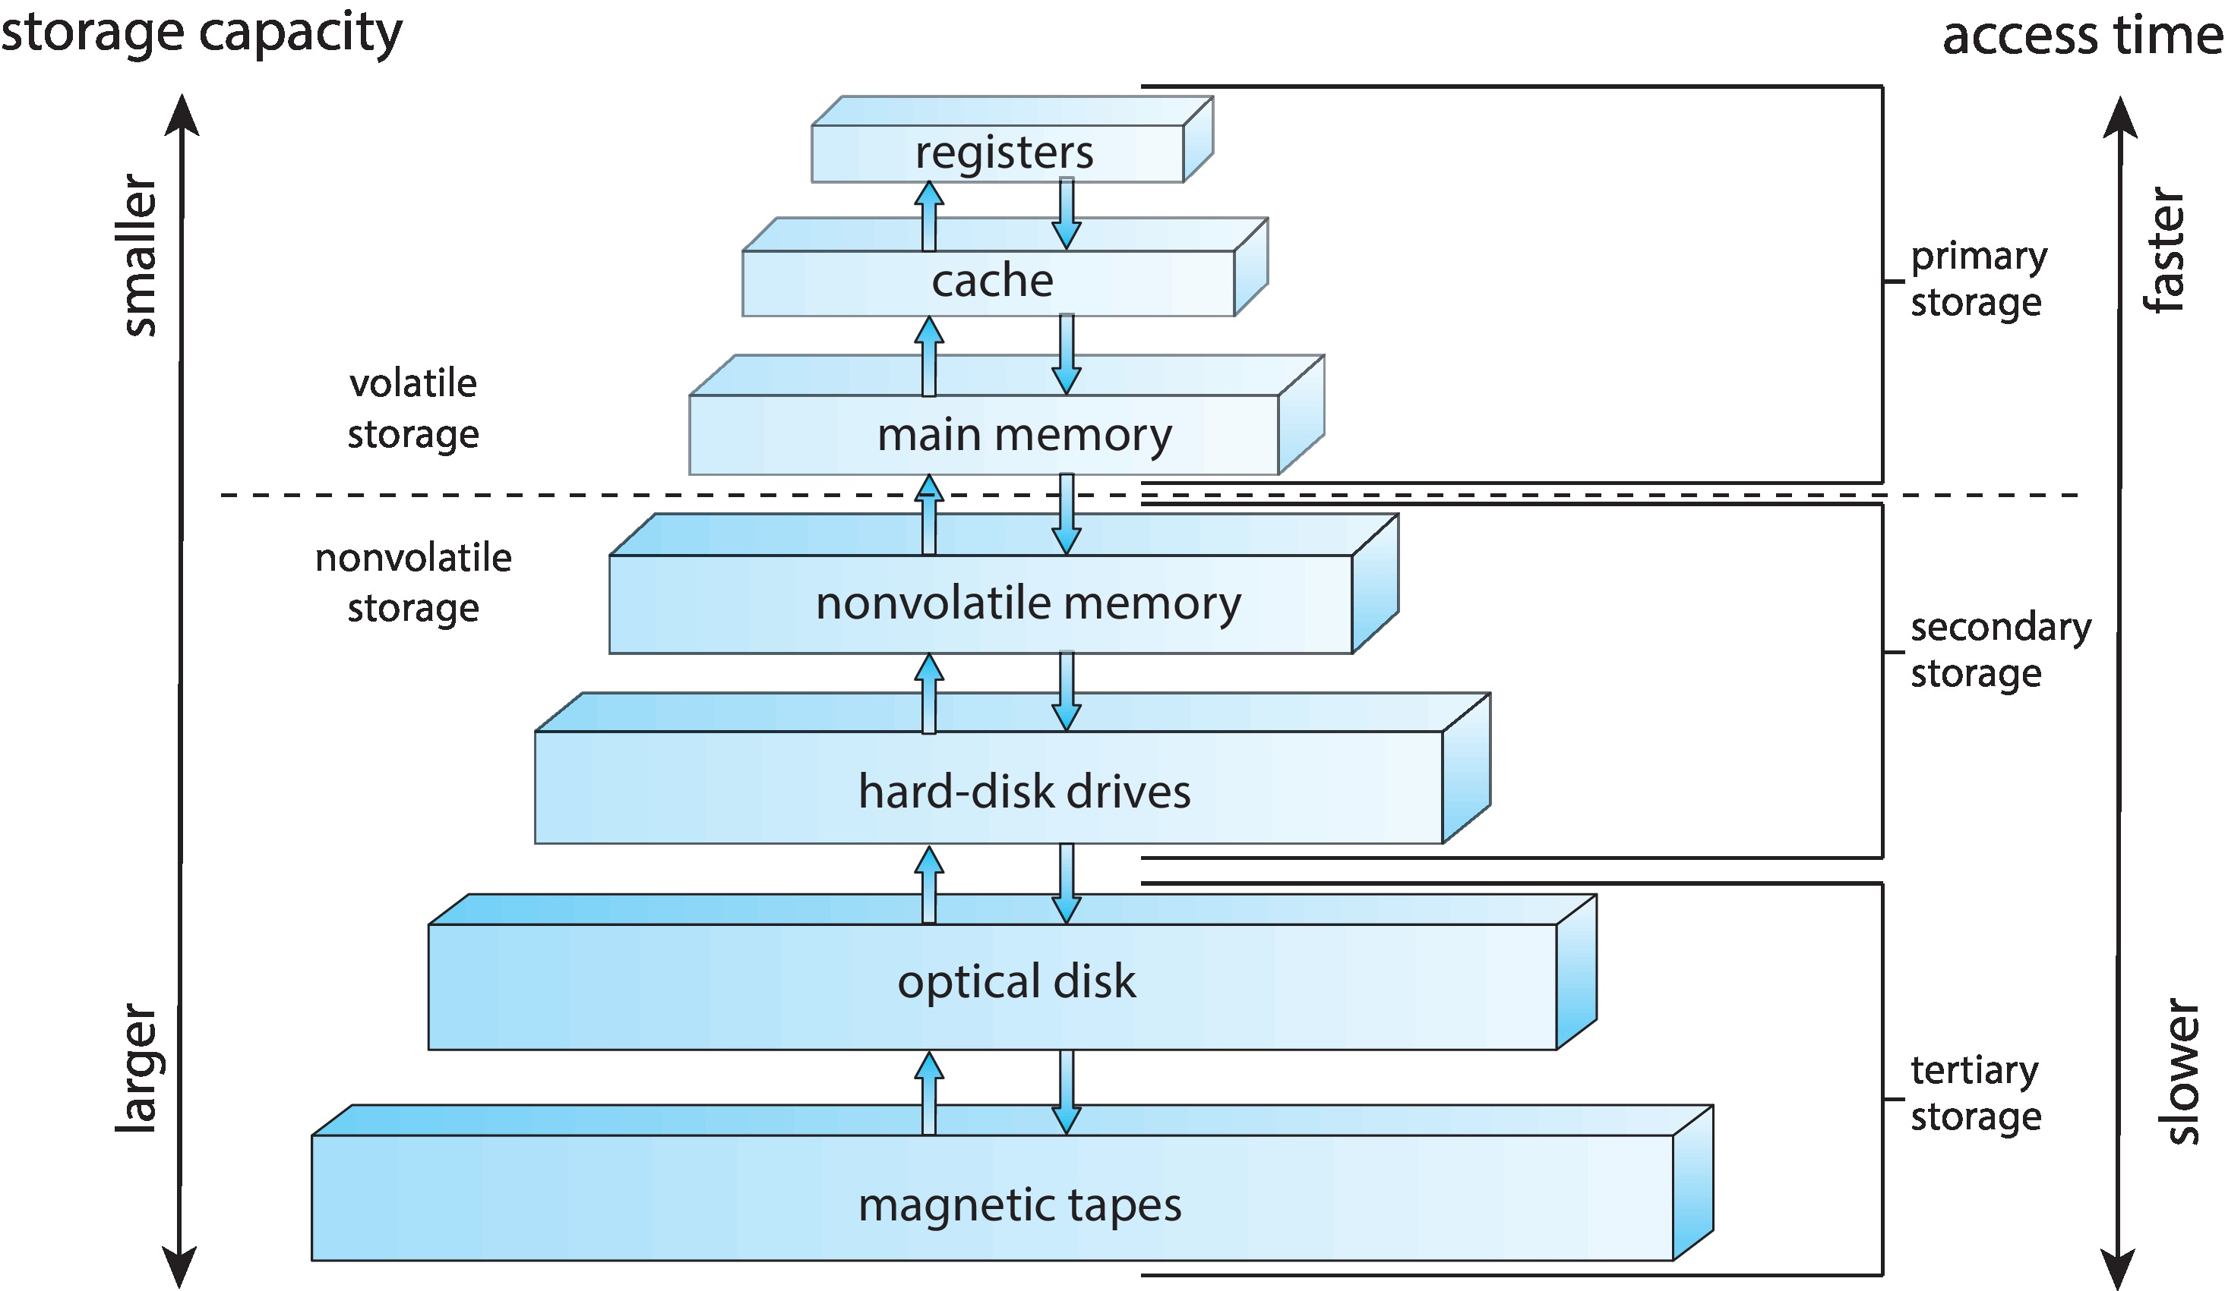
Storage-Device Hierarchy

Slide 9
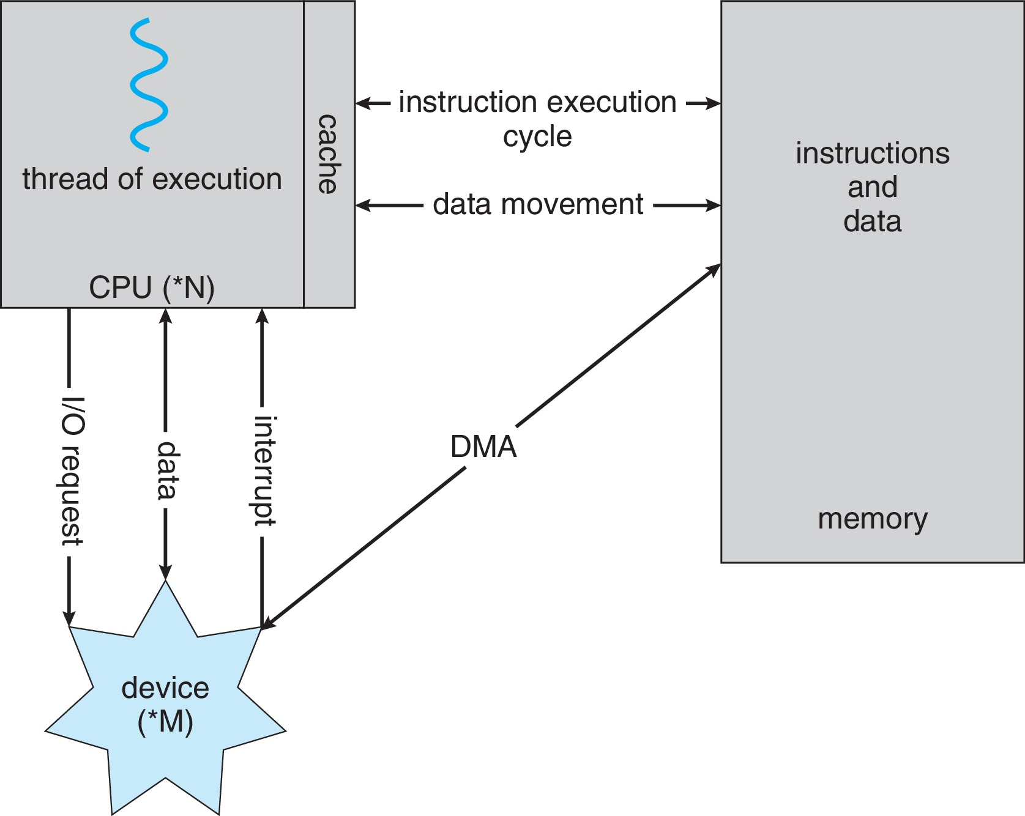
How a Modern Computer Works
A von Neumann architecture

Slide 10
Direct Memory Access Structure
Used for high-speed I/O devices able to transmit information at close to memory speeds
Device controller transfers blocks of data from buffer storage directly to main memory without CPU intervention
Only one interrupt is generated per block, rather than the one interrupt per byte

Slide 11
Operating-System Operations
Bootstrap program – simple code to initialize the system, load the kernel
Kernel loads
Starts system daemons (services provided outside of the kernel)
Kernel interrupt driven (hardware and software)
Hardware interrupt by one of the devices
Software interrupt (exception or trap):
Software error (e.g., division by zero)
Request for operating system service – system call
Other process problems include infinite loop, processes modifying each other or the operating system

Slide 12
Multiprogramming (Batch system)
Single user cannot always keep CPU and I/O devices busy
Multiprogramming organizes jobs (code and data) so CPU always has one to execute
A subset of total jobs in system is kept in memory
One job selected and run via job scheduling
When job has to wait (for I/O for example), OS switches to another job

Slide 13
Multitasking (Timesharing)
A logical extension of Batch systems– the CPU switches jobs so frequently that users can interact with each job while it is running, creating interactive computing
Response time should be < 1 second
Each user has at least one program executing in memory  process
If several jobs ready to run at the same time  CPU scheduling
If processes don’t fit in memory, swapping moves them in and out to run
Virtual memory allows execution of processes not completely in memory

Slide 14
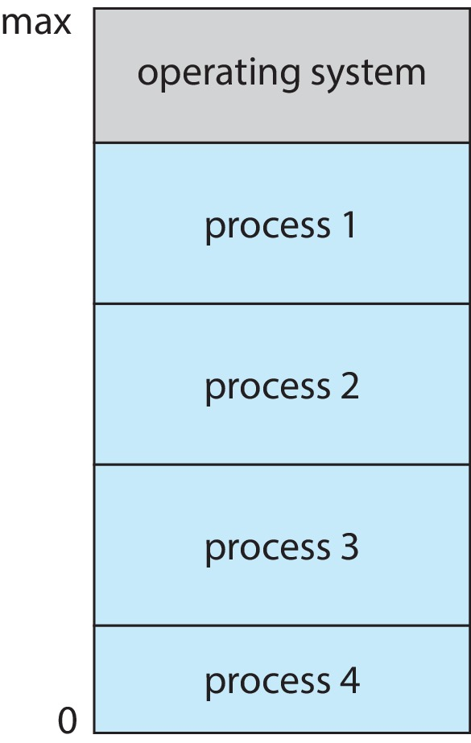
Memory Layout for Multiprogrammed System

Slide 15
Dual-mode Operation
Dual-mode operation allows OS to protect itself and other system components
User mode and kernel mode
Mode bit provided by hardware
Provides ability to distinguish when system is running user code or kernel code.
When a user is running  mode bit is “user”
When kernel code is executing  mode bit is “kernel”
How do we guarantee that user does not explicitly set the mode bit to “kernel”?
System call changes mode to kernel, return from call resets it to user
Some instructions designated as privileged, only executable in kernel mode

Slide 16
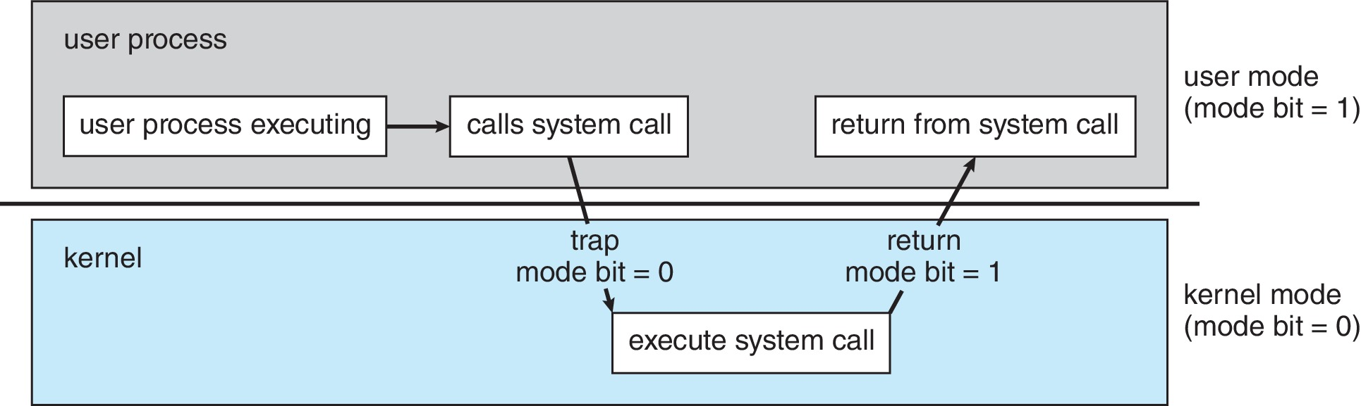
Transition from User to Kernel Mode

Slide 17
Virtualization
Allows operating systems to run applications within other OSes
Vast and growing industry
Emulation used when source CPU type different from target type (i.e. PowerPC to Intel x86)
Generally slowest method
When computer language not compiled to native code – Interpretation
Virtualization – OS natively compiled for CPU, running guest OSes also natively compiled
Consider VMware running WinXP guests, each running applications, all on native WinXP host OS
VMM (virtual machine Manager) provides virtualization services

Slide 18
Virtualization (cont.)
Use cases involve laptops and desktops running multiple OSes for exploration or compatibility
Apple laptop running Mac OS X host, Windows as a guest
Developing apps for multiple OSes without having multiple systems
Quality assurance testing applications without having multiple systems
Executing and managing compute environments within data centers
VMM can run natively, in which case they are also the host
There is no general-purpose host then (VMware ESX and Citrix XenServer)

Slide 19
Computing Environments - Virtualization

Slide 20
Computer System Environments

Slide 21
Computing Environments
Traditional
Mobile
Client Server
Peer-to-Peer
Cloud computing
Real-time Embedded

Slide 22
Traditional
Stand-alone general-purpose machines
But blurred as most systems interconnect with others (i.e., the Internet)
Portals provide web access to internal systems
Network computers (thin clients) are like Web terminals
Mobile computers interconnect via wireless networks
Networking becoming ubiquitous – even home systems use firewalls to protect home computers from Internet attacks

Slide 23
Mobile
Handheld smartphones, tablets, etc.
What is the functional difference between them and a “traditional” laptop?
Extra feature – more OS features (GPS, gyroscope)
Allows new types of apps like augmented reality
Use IEEE 802.11 wireless, or cellular data networks for connectivity
Leaders are Apple iOS and Google Android

Slide 24
Client Server
Client-Server Computing
Dumb terminals supplanted by smart PCs
Many systems now servers, responding to requests generated by clients
Compute-server system provides an interface to client to request services (i.e., database)
File-server system provides interface for clients to store and retrieve files

Slide 25
Peer-to-Peer
Another model of distributed system
P2P does not distinguish clients and servers
Instead all nodes are considered peers
May each act as client, server or both
Node must join P2P network
Registers its service with central lookup service on network, or
Broadcast request for service and respond to requests for service via discovery protocol
Examples include Napster and Gnutella, Voice over IP (VoIP) such as Skype

Slide 26
Cloud Computing
Delivers computing, storage, even apps as a service across a network
Logical extension of virtualization because it uses virtualization as the base for it functionality.
Amazon EC2 has thousands of servers, millions of virtual machines, petabytes of storage available across the Internet, pay based on usage

Slide 27
Cloud Computing (Cont.)
Many types
Public cloud – available via Internet to anyone willing to pay
Private cloud – run by a company for the company’s own use
Hybrid cloud – includes both public and private cloud components
Software as a Service (SaaS) – one or more applications available via the Internet (i.e., word processor)
Platform as a Service (PaaS) – software stack ready for application use via the Internet (i.e., a database server)
Infrastructure as a Service (IaaS) – servers or storage available over Internet (i.e., storage available for backup use)

Slide 28
Cloud Computing (cont.)
Cloud computing environments composed of traditional OSes, plus VMMs, plus cloud management tools
Internet connectivity requires security like firewalls
Load balancers spread traffic across multiple applications

Slide 29
Real-Time Embedded Systems
Real-time embedded systems most prevalent form of computers
Vary considerable, special purpose, limited purpose OS, real-time OS
Use expanding
Many other special computing environments as well
Some have OSes, some perform tasks without an OS
Real-time OS has well-defined fixed time constraints
Processing must be done within constraint
Correct operation only if constraints met

Slide 30
Free and Open-Source Operating Systems
Operating systems made available in source-code format rather than just binary closed-source and proprietary
Counter to the copy protection and Digital Rights Management (DRM) movement
Started by Free Software Foundation (FSF), which has “copyleft” GNU Public License (GPL)
Free software and open-source software are two different ideas championed by different groups of people
https://www.gnu.org/philosophy/open-source-misses-the-point.en.html
Examples include GNU/Linux and BSD UNIX (including core of Mac OS X), and many more
Can use VMM like VMware Player (Free on Windows), Virtualbox (open source and free on many platforms - http://www.virtualbox.com)
Use to run guest operating systems for exploration

Slide 31
The Study of Operating Systems
There has never been a more interesting time to study operating systems, and it has never been
easier. The open-source movement has overtaken operating systems, causing many of them to be
made available in both source and binary (executable) format. The list of operating
systems available in both formats includes Linux, BUSD UNIX, Solaris, and part of macOS.
The availability of source code allows us to study operating systems from the inside out.
Questions that we could once answer only by looking at documentation or the behavior of an
operating system we can now answer by examining the code itself.
Operating systems that are no longer commercially viable have been open-sourced as well, enabling
us to study how systems operated in a time of fewer CPU, memory, and storage resources.
An extensive but incomplete list of open-source operating-system projects is available
from https://curlie.org/Computers/Software/Operating_Systems/Open_Source/
In addition, the rise of virtualization as a mainstream (and frequently free) computer function
makes it possible to run many operating systems on top of one core system. For example, VMware
(http://www.vmware.com) provides a free “player” for Windows on which hundreds of free
“virtual appliances” can run. Virtualbox (http://www.virtualbox.com) provides a free, open-source
virtual machine manager on many operating systems. Using such tools, students can try out
hundreds of operating systems without dedicated hardware.
The advent of open-source operating systems has also made it easier to make the move from
student to operating-system developer. With some knowledge, some effort, and an Internet
connection, a student can even create a new operating-system distribution. Just a few years ago,
it was difficult or impossible to get access to source code. Now, such access is limited only by
how much interest, time, and disk space a student has.

Slide 32
End of Chapter 1

